Slide 1
Welcome to Himilcon’s lab for EDUC 275B (Data II)!
Lab 3
Thursday, February 8, 2024
Himilcon Inciarte
himilcon_Inciarte@berkeley.edu

Slide 2
Upcoming Assignments
Quiz 1b:
02/11/2024
Homework 3 & 4:
02/26/2024
Project 1:
03/22/2024

Slide 3
Quiz 1a

Slide 4
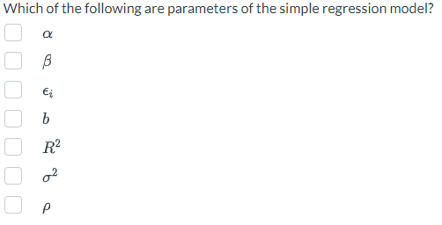
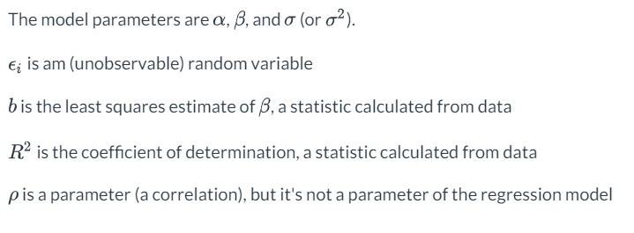

Slide 5
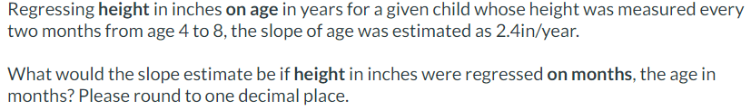

Slide 6
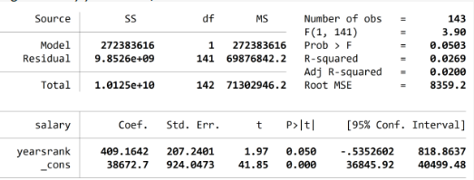
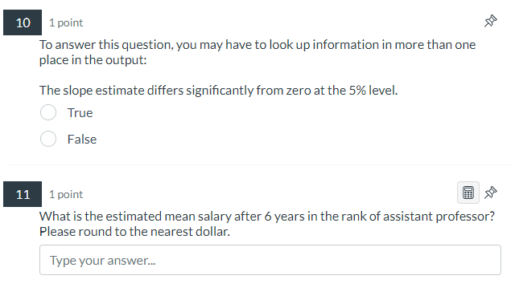

Slide 8
HW 1 and 2

Slide 9
Handout: Output

Slide 10
Lab 02.do

Slide 11
Practice

Slide 12
Label the variable gender
How many labels are in the database now?
Create a histogram for market. Is it normally distributed?
What is the mean and standard deviation for salary?
How many values can rank take?

Slide 13
HW 3 and 4

